Slide 1
Go language
Anand Hariharan
Practice Head, Google

Slide 2
Module 5
writing a web application
using gorilla and default http package basics only
writing a get function
writing a post function
hands on exercises

Slide 3
Web clients
The net/http package provides a series of functions and types for sending HTTP requests.
The most important types are:
the Client
the Request
the Response

Slide 4
Web clients
The Client type offers some other methods related directly to the HTTP methods:
Client.Get
Client.Post
Client.PostForm
Client.Head
and the equivalent helper functions:
http.Get
http.Post
http.PostForm
http.Head

Slide 5
Gorilla mux
Gorilla is a web toolkit for the Go programming language. Currently these packages are available:
gorilla/context stores global request variables.
gorilla/mux is a powerful URL router and dispatcher.
gorilla/reverse produces reversible regular expressions for regexp-based muxes.
gorilla/rpc implements RPC over HTTP with codec for JSON-RPC.
gorilla/schema converts form values to a struct.
gorilla/securecookie encodes and decodes authenticated and optionally encrypted cookie values.
gorilla/sessions saves cookie and filesystem sessions and allows custom session backends.
gorilla/websocket implements the WebSocket protocol defined in RFC 6455.
The name mux stands for "HTTP request multiplexer"
to install the mux package in your machine you can use go get
$ go get github.com/gorilla/mux

Slide 6
Main features of mux
Requests can be matched based on URL host, path, path prefix, schemes, header and query values, HTTP methods or using custom matchers.
URL hosts and paths can have variables with an optional regular expression.
Registered URLs can be built, or "reversed", which helps maintaining references to resources.
Routes can be used as subrouters: nested routes are only tested if the parent route matches. This is useful to define groups of routes that share common conditions like a host, a path prefix or other repeated attributes. As a bonus, this optimizes request matching.
It implements the http.Handler interface so it is compatible with the standard http.ServeMux.

Slide 7
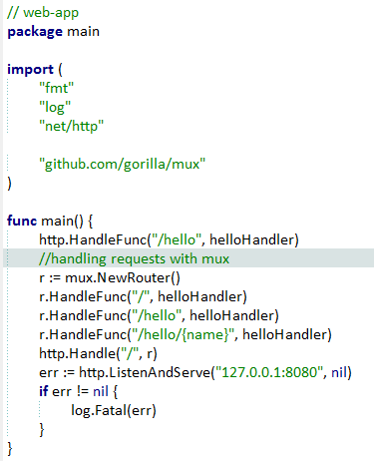
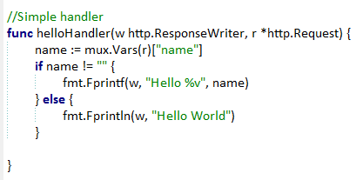
Example – Simple routing

Slide 8
Additional reading
https://kev.inburke.com/kevin/golang-json-http/
http://thenewstack.io/make-a-restful-json-api-go/

Slide 9
Anand Hariharan
Practice Head
anand.hariharan@wipro.com

